Slide 1
Chapter 3: Biopsychology

Slide 2
BIOPSYCHOLOGY
Biopsychology explores the biological mechanisms that underlie behavior.
Among many things, it studies:
Genetics - focusing on how inherited genes can affect not just the physiological, but psychological traits of a person.
The structure and function of the nervous system.
How the nervous system interacts with the endocrine system.

Slide 3
HUMAN GENETICS
Studying human genetics can help researchers understand the biological basis underlying the different behaviors, thoughts and reactions of humans.
Why do two people infected by the same disease have different outcomes?
Are there genetic components to psychological disorders, such as depression?
How are genetic diseases passed through family lines?
Notes:
Why would psychologists study genetics?

Slide 4
EVOLUTIONARY PSYCHOLOGY (1)
General patterns of human behavior promote our survival as a species
Charles Darwin explored the concept of inheritance of traits throughout generations in his theory of evolution through natural selection.
The organisms that are better suited for their environment will survive and reproduce, while those that are poorly suited for their environment will die off.

Slide 5
EVOLUTIONARY PSYCHOLOGY (2)
Characteristics and behaviors that impact survival and reproduction:
Those that help protect against predators.
Those that increase access to food.
Those that help to offspring alive.
”It is not the strongest of the species that survives, nor the most intelligent that survives. It is the one that is most adaptable to change.” – Charles Darwin

Slide 6
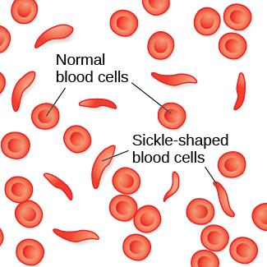
Evolutionary Psychology (3)
So why have certain genetic diseases that cause people to die not become less common?
Example: Sickle cell anemia
A genetic condition in which red blood cells take on a crescent-like shape affecting how they function.
Causes many people to die at an early age but it is still common among people of African descent.
Carriers of only one copy of the sickle cell gene are thought to be immune from malaria, a deadly disease which is common in Africa.
In this example, carrying the gene makes a person better suited for their environment.

Slide 7
GENETIC VARIATION (1)
The genetic difference between individuals.
Contributes to a species’ adaptation to its environment.
Begins when an egg (containing 23 chromosomes) is fertilized by a sperm (containing 23 chromosomes).

Slide 8
GENETIC VARIATION (2)
Chromosome - long strand of genetic information known as DNA.
Deoxyribonucleic acid (DNA) - helix-shaped molecule made of nucleotide base pairs.
In each chromosome, sequences of DNA make up genes.
Gene - sequence of DNA that controls or partially controls physical characteristics known as traits (eye color, hair color etc).
A gene may have multiple possible variations or alleles (a specific version of a gene).
A specific gene may code for hair color and the different alleles of that gene affect what the hair color will be.

Slide 9
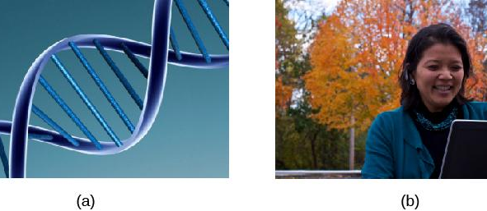
GENOTYPE VS PHENOTYPE
GENOTYPE
PHENOTYPE
Genotype refers to the genetic makeup of an individual based on the genetic material (DNA) inherited from one’s parents.
Phenotype describes an individual’s observable characteristics, such as hair color, skin color, height, and build.

Slide 10
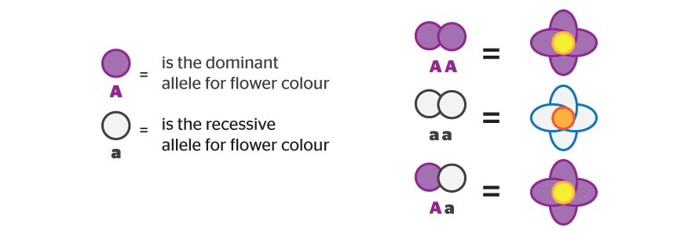
DOMINANT V RECESSIVE ALLELES
The majority inheritable traits are controlled by more than just one gene and in such cases, they are known as polygenic traits.
Some traits are controlled by one gene.
Alleles can be dominant or recessive. In the example below
Possession of a dominant allele will always result in expression of that phenotype. This could be inherited from one parent (Aa) or both parents (AA).
The phenotype of a recessive allele will only be physically expressed if the person is homozygous for that allele, meaning they inherited a recessive allele from BOTH parents (aa).
Heterozygous - consisting of two different alleles (Aa).
Homozygous - consisting of two identical alleles (AA/aa).
Notes:
A is the dominant allele for flower color (purple) and a is the recessive allele for flower color (white).

Slide 11
Dominant Trait | Recessive Trait
Brown eyes | Gray green, hazel, or blue eyes
Dark hair | Blond hair
Nonred hair | Red hair
Curly hair | Straight hair
Normal vision | Nearsightedness
Farsightedness | Normal vision
Broad lips | Thin lips
Double jointed | Normal joints
Pigmented skin | Albinism
Type A blood | Type O blood
Type B blood | Type O blood
Notes:
Most human traits are polygenetic

Slide 12
GENE-ENVIRONMENT INTERACTIONS (1)
Nature vs. Nurture issue: Are genetics or environment more important for shaping an individual’s behaviors?

Slide 13
GENE-ENVIRONMENT INTERACTIONS (2)
Nature and nurture work together like complex pieces of a human puzzle.
The interaction of our environment and genes makes us the individuals we are.
There are many different ways to look at this interaction:
Range of reaction - asserts our genes set the boundaries within which we can operate, and our environment interacts with the genes to determine where in that range we will fall
Genetic environmental correlation - view of gene-environment interaction that asserts our genes affect our environment, and our environment influences the expression of our genes.
Epigenetics - study of gene-environment interactions such as how the same genotype leads to different phenotypes.

Slide 14
The Nervous System

Slide 15
CELLS OF THE NERVOUS SYSTEM
The nervous system is made up of two types of cells:
Neurons - the basic units of the nervous system; responsible for conducting nerve impulses needed for tasks associated with the nervous system.
Responsible for the reception, conduction and transmission of electrochemical signals.
Glial cell - provides physical and metabolic support to neurons, including neuronal insulation and communication and nutrient and waste transport.
The glue.
Outnumber neurons ten to one.
Include Oligodendrocytes, Schwann cells, astrocytes, and microglia.

Slide 16
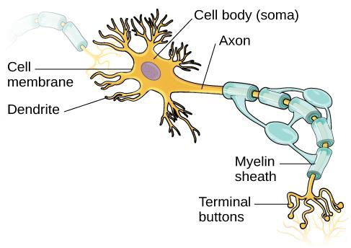
NEURON STRUCTURE
Notes:
The function of a neuron is aided by specific aspects of its structure.
Its semi-permeable membrane allows smaller molecules or molecules without an electrical charge to pass through it, while stopping larger or highly charged molecules.
Incoming electrical signals from other neurons are received by the dendrites which then send the signal down the axon.
Axons are covered in a myelin sheath made of a fatty substance that insulates axons and allows the signal to travel down the axon quicker.
At the end of the axons are terminal buttons which contain synaptic vessels (storage sites for chemical messengers called neurotransmitters).

Slide 17
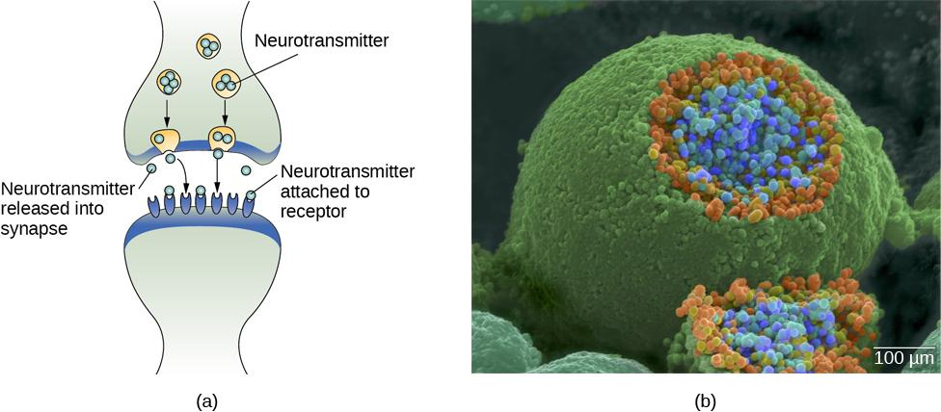
THE SYNAPSE
Notes:
The synapse is the space between the terminal button of one neuron and the dendrite of another neuron.
In this pseudo-colored image from a scanning electron microscope, a terminal button (green) has been opened to reveal the synaptic vesicles (orange and blue) inside. Each vesicle contains about 10,000 neurotransmitter molecules.

Slide 18
NEURONAL COMMUNICATION (1)
Neural communication is an electrochemical event.
Neurons are surrounded by extracellular fluid and contain intracellular fluid. The communication of an electrical signal depends on these fluids being electrically different.
Membrane potential - difference in charge across the neuronal membrane.
These fluids contain ions which cause the electrical charge.
Sodium (Na+)
Chloride (Cl‾)
Potassium (K+)
Negatively charged proteins (A‾)

Slide 19
NEURONAL COMMUNICATION (2)
Before a Neuron Fires
Resting potential - the state of readiness of a neuron membrane’s potential between signals (-70mv).
The membrane is polarized.
The charge inside is more negative than the outside.

Slide 20
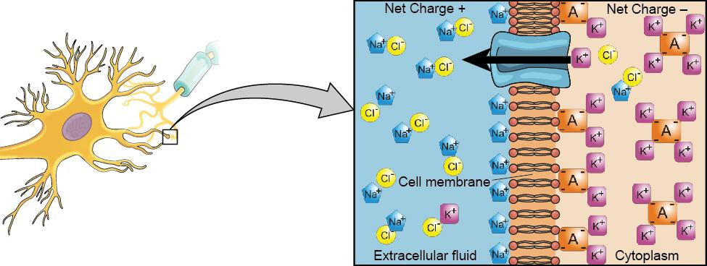
NEURONAL COMMUNICATION
Notes:
At resting potential, Na⁺ (blue pentagons) is more highly concentrated outside the cell in the extracellular fluid (shown in blue).
K⁺ (purple squares) is more highly concentrated near the membrane in the cytoplasm or intracellular fluid.
Other molecules, such as chloride ions (yellow circles) and negatively charged proteins (brown squares), help contribute to a positive net charge in the extracellular fluid and a negative net charge in the intracellular fluid.

Slide 21
ACTION POTENTIAL (1)
Neurotransmitters from nearby neurons attach to receptors on dendrites causing the membrane potential to change.
  Depolarization – membrane potential becomes less negative making the neuron more likely to fire (excitation).
  Hyperpolarization – membrane potential becomes more negative making the neuron less likely to fire (inhibition).

Slide 22
ACTION POTENTIAL (2)
If the level of charge reaches the threshold of excitation an action potential will occur. Ion channels open causing Na+ to rush into the cell and the inside to momentarily become more positive.
  Threshold of excitation – level of charge in the membrane that causes the neuron to become active.
  Action Potential – an electrical signal.
  Action potentials act on an all-or-none principle - the incoming signal is either sufficient to reach the threshold of excitation or it is not.

Slide 23
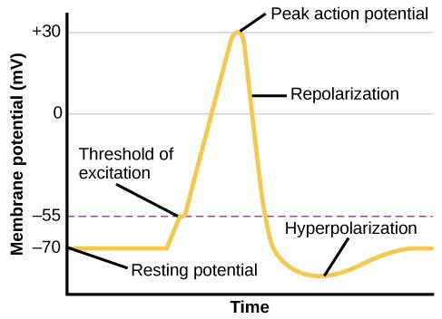
ACTION POTENTIAL
Notes:
During the action potential, the electrical charge across the membrane changes dramatically.

Slide 24
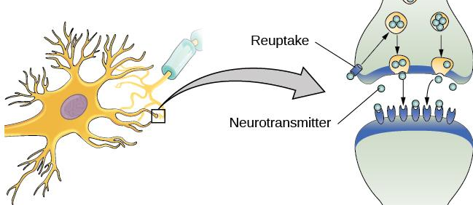
REUPTAKE
Notes:
Once an action potential has occurred, excess neurotransmitters in the synapse either drift away, are broken down or are reabsorbed.
Reuptake involves moving a neurotransmitter from the synapse back into the axon terminal from which it was released.
SSRIs

Slide 25
NEUROTRANSMITTERS
Neurotransmitters (NTs) – chemical messenger of the nervous system.
Different neurons release different types of neurotransmitters that have many different functions.
Biological perspective - view that psychological disorders like depression and schizophrenia are associated with imbalances in one or more neurotransmitter systems.

Slide 26
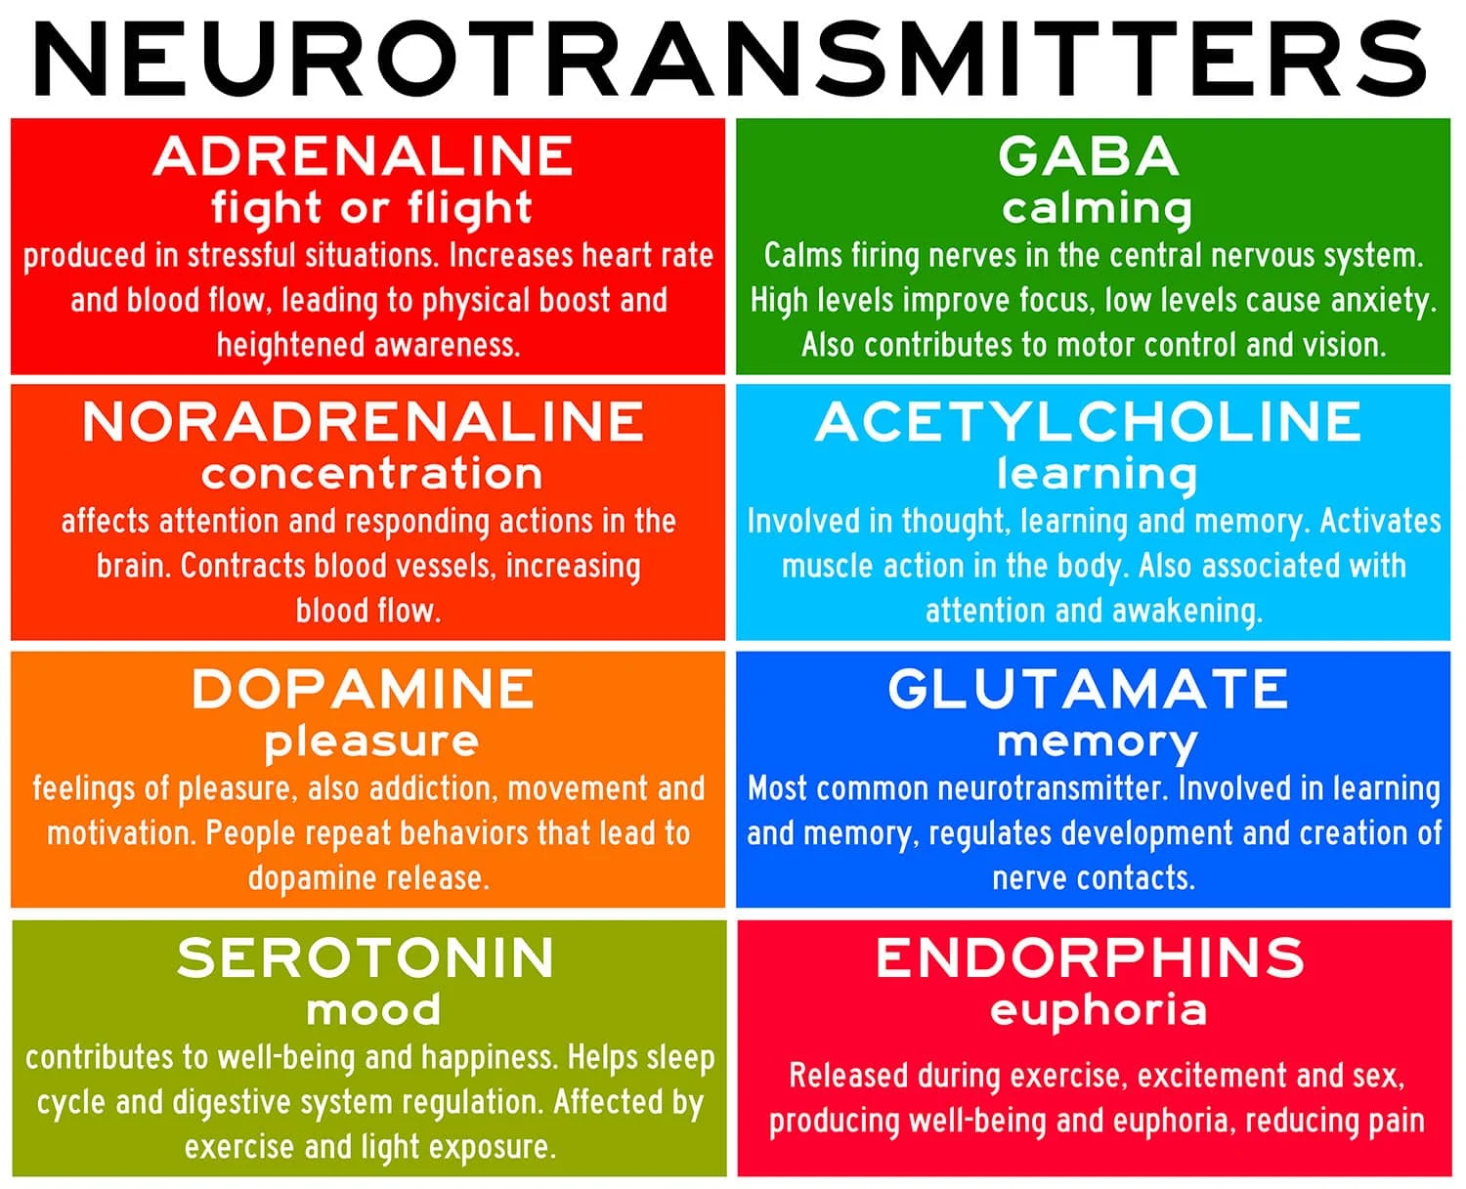
Notes:
Satisfies Learning Objective 1: Explain what a neuron is and how it functions.
Proteins produced by nervous system: Different neurotransmitters serve different functions, depending on the type of neuron and the part of the brain.
Classification of neurotransmitters:
The fundamental criterion for this classification is that the chemical must bridge the synapse and induce an electric current in a dendrite.
Neurotransmitters that increase activity in the neuron are said to be excitatory.
Neurotransmitters that decrease activity in the neuron are said to be inhibitory.
Common neurotransmitters: Dopamine, acetylcholine, serotonin, gamma-aminobutyric acid (GABA), and norepinephrine.
Effects of malfunctions in chemical production:
Malfunctions of the systems that produce these chemicals may cause neurological disorders.
For example, in Parkinson’s disease, a part of the brain (the substantia nigra) is no longer able to produce enough dopamine, resulting in the characteristic movement disorders of the disease.
Substantia nigra: A part of the brain that produces dopamine.
Sometimes, the process of production of neurotransmitters is altered in order to treat psychiatric conditions.
Orally consumed drugs can alter the functioning of many of these neurotransmitters.
For example, cocaine blocks the flow of dopamine.
Nicotine, the main active drug in tobacco products, increases the activation of the neurons that innervate our muscles.

Slide 27
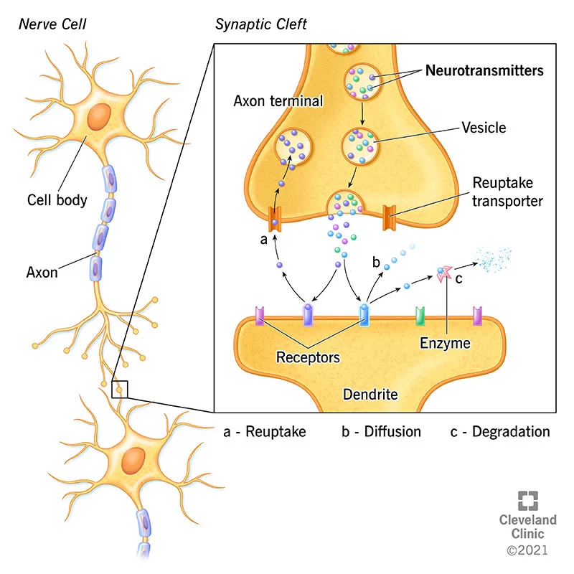
Notes:
Satisfies Learning Objective 1: Explain what a neuron is and how it functions.
Proteins produced by nervous system: Different neurotransmitters serve different functions, depending on the type of neuron and the part of the brain.
Classification of neurotransmitters:
The fundamental criterion for this classification is that the chemical must bridge the synapse and induce an electric current in a dendrite.
Neurotransmitters that increase activity in the neuron are said to be excitatory.
Neurotransmitters that decrease activity in the neuron are said to be inhibitory.
Common neurotransmitters: Dopamine, acetylcholine, serotonin, gamma-aminobutyric acid (GABA), and norepinephrine.
Effects of malfunctions in chemical production:
Malfunctions of the systems that produce these chemicals may cause neurological disorders.
For example, in Parkinson’s disease, a part of the brain (the substantia nigra) is no longer able to produce enough dopamine, resulting in the characteristic movement disorders of the disease.
Substantia nigra: A part of the brain that produces dopamine.
Sometimes, the process of production of neurotransmitters is altered in order to treat psychiatric conditions.
Orally consumed drugs can alter the functioning of many of these neurotransmitters.
For example, cocaine blocks the flow of dopamine.
Nicotine, the main active drug in tobacco products, increases the activation of the neurons that innervate our muscles.

Slide 28
DRUGS (1)
Psychotropic medication - drugs that treat psychiatric symptoms by restoring neurotransmitter balance.
Agonist - drug that mimics or strengthens the effects of a neurotransmitter.
Antagonist - drug that blocks or impedes the normal activity of a given neurotransmitter.

Slide 29
DRUGS (2)
Agonist/antagonist drugs are prescribed to correct neurotransmitter imbalances.
  Parkinson’s disease is associated with low levels of dopamine. Dopamine agonists are often prescribed as one form of treatment.
  Schizophrenia on the other hand is associated with too much dopamine. Many antipsychotic drugs are therefore dopamine antagonists.

Slide 30
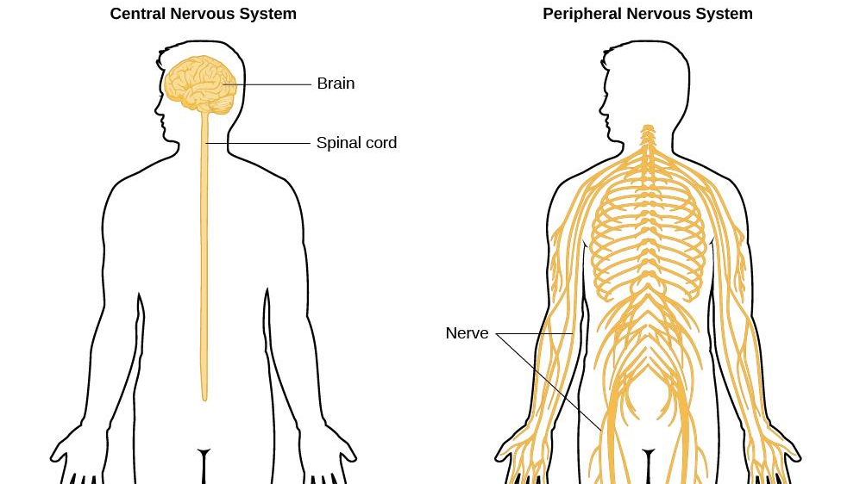
PARTS OF THE NERVOUS SYSTEM
Notes:
The nervous system is divided into two major parts:
the Central Nervous System – Brain and Spinal Cord
the Peripheral Nervous System.

Slide 31
THE PERIPHERAL NERVOUS SYSTEM (1)
The Peripheral nervous system is made up of two different parts:
Somatic nervous system - relays sensory and motor information to and from the CNS.
2. Autonomic nervous system - controls our internal organs and glands and can be divided into the Sympathetic and Parasympathetic nervous systems.
Notes:
The Sympathetic and Parasympathetic nervous systems complement each other to maintain homeostasis, a state of equilibrium in the body

Slide 32
THE PERIPHERAL NERVOUS SYSTEM (2)
Sympathetic nervous system - involved in stress-related activities and functions; prepares us for fight or flight.
  Fight or flight response - activation of the sympathetic division of the autonomic nervous system, allowing access to energy reserves and heightened sensory capacity so that we might fight off a given threat or run away to safety.
Parasympathetic nervous system - associated with routine, day-to-day operations of the body under relaxed conditions.
  Rest and restore response – relaxes the body after fight or flight (aka rest and digest).
Notes:
The Sympathetic and Parasympathetic nervous systems complement each other to maintain homeostasis, a state of equilibrium in the body

Slide 33
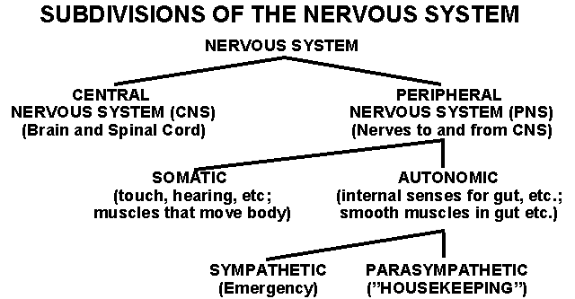
SUBDIVISIONS OF THE NERVOUS SYSTEM

Slide 34
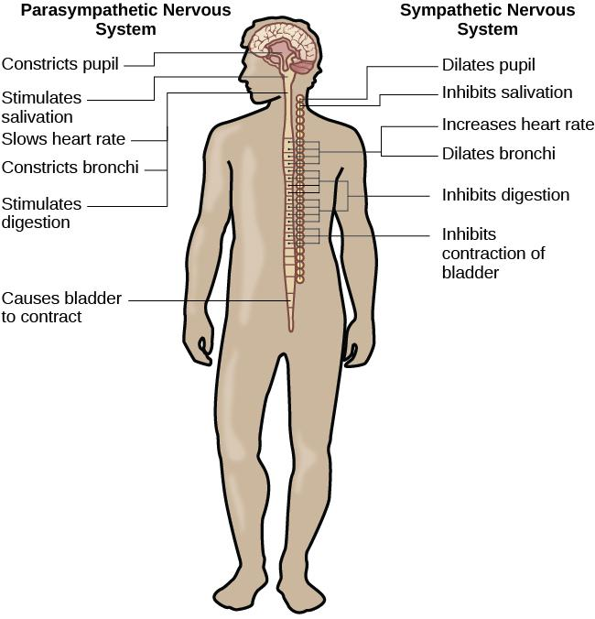
THE AUTONOMIC NERVOUS SYSTEM

Slide 35
THE BRAIN
THE BRAIN
Comprised of billions of interconnected neurons and glia.
Bilateral (two-sided).
Can be separated into distinct lobes but all areas interact with one another.

Slide 36
THE SPINAL CORD
THE SPINAL CORD
Delivers messages to and from the brain.
Has its own system of reflexes.
The top merges with the brain stem and the bottom ends just below the ribs
Functionally organized into 30 segments, each connected to a specific part of the body through the PNS.
Sensory nerves bring messages in and up to the brain; motor nerves send messages out to the muscles and organs.
In moments of survival, automatic reflexes allow motor commands to be initiated without sending signals from sensory nerves to the brain first, allowing for very quick reactions.

Slide 37
THE TWO HEMISPHERES (1)
The surface of the brain, known as the cerebral cortex is covered with bumps and folds called gyri, small grooves called sulci and large grooves called fissures such as the longitudinal fissure that divides the brain into left and right hemispheres.
Lateralization - concept that each hemisphere of the brain is associated with specialized functions.
The left hemisphere controls the right side of the body.
The right hemisphere controls the left side of the body.

Slide 38
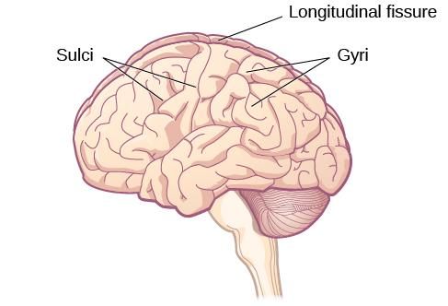
THE TWO HEMISPHERES (2)
Notes:
Cortical folds

Slide 39
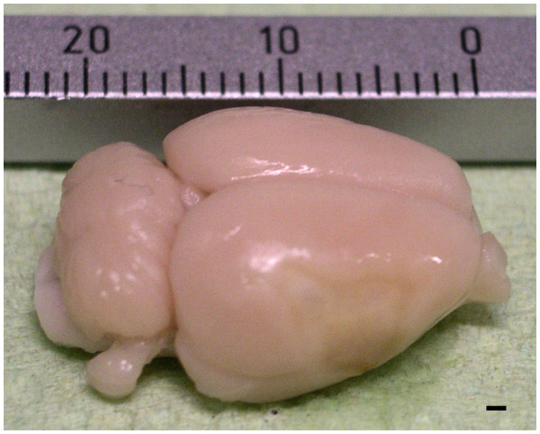

Slide 40
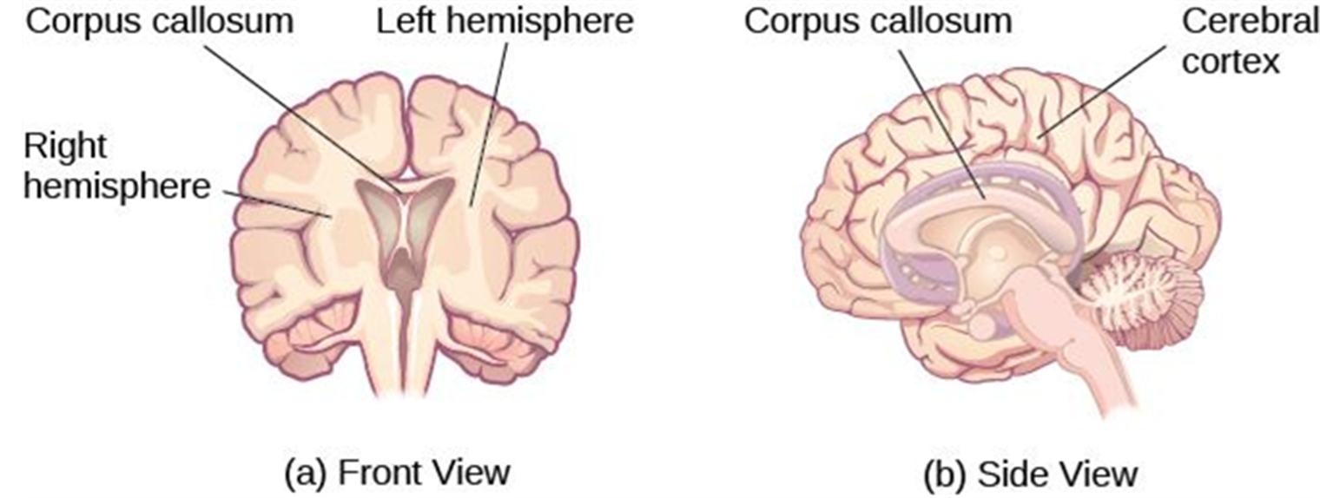
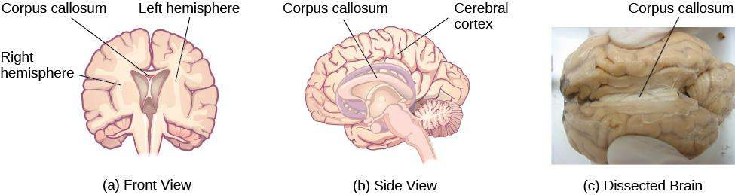
THE CORPUS CALLOSUM (1)
Notes:
a, b) The corpus callosum connects the left and right hemispheres of the brain and allows them to communicate.
(c) A scientist spreads this dissected sheep brain apart to show the corpus callosum between the hemispheres.
Figure 3.16 (credit c: modification of work by Aaron Bornstein)

Slide 41
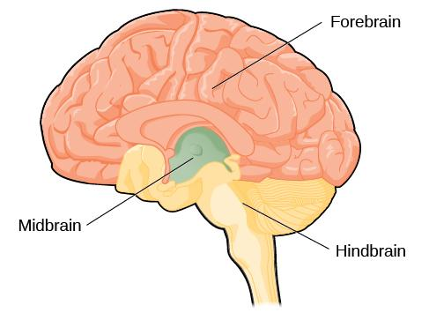
FOREBRAIN, MIDBRAIN & HINDBRAIN
Notes:
The brain and its parts can be divided into three main categories: the forebrain, midbrain, and hindbrain.

Slide 42
FOREBRAIN STRUCTURES
The forebrain is the largest part of the brain.
It contains:
The cerebral cortex – higher level processes
Thalamus - sensory relay
Hypothalamus - homeostasis
Pituitary gland – master gland of the endocrine system
Limbic system – emotion and memory circuit

Slide 43
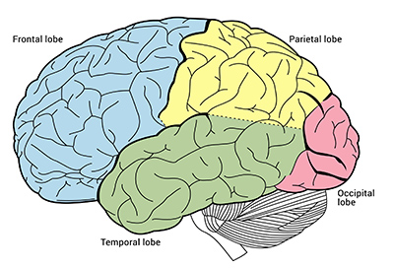
Cerebral Cortex and Lobes of the Brain
The Cerebral Cortex
Cortex: brain’s wrinkled and folded outermost layer that composes about 85% of the brain’s mass and is comprised of four lobes
  Frontal lobes
  Temporal lobe
  Parietal lobe
  Occipital lobe
Notes:
Learning Objective: 4-1: Describe the parts of the neuron and brain and the role of experience in brain development.
C. The Cerebral Cortex
a. Cortex: the brain’s wrinkled and folded outermost layer that composes about 85% of the brain’s mass and is comprised of four lobes
i. Frontal lobes—involved in complex thought, planning, movement, language, and impulse control
ii. Temporal lobe—processes auditory information and plays a role in language and memory
iii. Parietal lobe—integrates sensory input, spatial location, and plays a role in motor control
iv. Occipital lobe—processes vision
b. Prefrontal cortex: the part of the frontal lobe that is responsible for executive function (planning, goal setting, controlling impulses) and using cognitive skills and memory to solve problems; develops throughout infancy, childhood, and adolescence and matures into early adulthood

Slide 44
THE FRONTAL LOBE
Involved in executive functioning (planning, organization, judgement, attention, reasoning), motor control, emotion, and language.
It contains:
The Motor cortex - strip of cortex involved in planning and coordinating movement.
The Prefrontal cortex - responsible for higher-level cognitive functioning.
Broca’s area - region in the left hemisphere that is essential for language production.
Damage to Broca’s area leads to difficulties producing language.
.

Slide 45
DAMAGE TO THE FRONTAL LOBE
Damage to the Frontal Lobe: Phineas Gage
While working as a railroad foreman, an accident caused an iron rod to penetrate through Gage’s skull and frontal lobe. After the accident, people noticed changes in his personality.
Before the accident - Well-mannered and soft-spoken.
After the accident - Started behaving in odd and inappropriate ways.
These changes were consistent with loss of impulse control (a function of the frontal lobe).

Slide 46
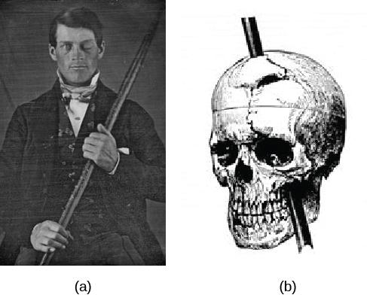
PHINEAS GAGE
Notes:
Figure 3.19
Phineas Gage holds the iron rod that penetrated his skull in an 1848 railroad construction accident.
Gage’s prefrontal cortex was severely damaged in the left hemisphere. The rod entered Gage’s face on the left side, passed behind his eye, and exited through the top of his skull, before landing about 80 feet away. (credit a: modification of work by Jack and Beverly Wilgus)

Slide 47
THE PARIETAL LOBE
Involved in processing various sensory and perceptual information.
Contains the primary somatosensory cortex.
Somatosensory cortex – essential for processing sensory information from across the body, such as touch, temperature, and pain.
Organized topographically.

Slide 48
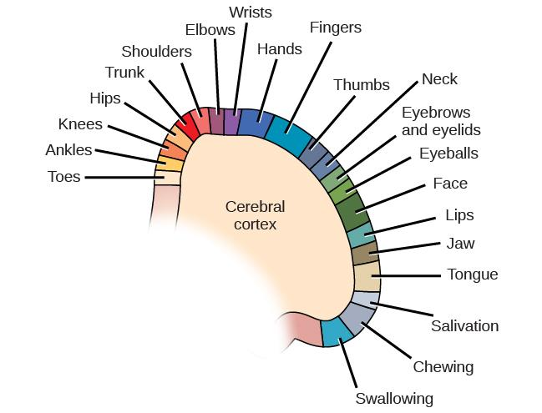
THE PARIETAL LOBE (2)

Slide 49
THE TEMPORAL LOBE (1)
Associated with hearing, memory, emotion and some aspects of language.
Located on the side of the head (near the temples).
It contains:
The Auditory cortex - strip of cortex in the temporal lobe that is responsible for processing auditory information.
Wernicke’s area - important for speech comprehension.
Damage to Wernicke’s area results in difficulty understanding language.

Slide 50
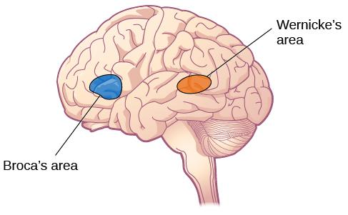
THE TEMPORAL LOBE (2)

Slide 51
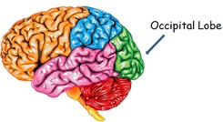
THE OCCIPITAL LOBE
Associated with visual processing.
Contains the primary visual cortex which is responsible for interpreting incoming visual information.
Organized retinotopically.

Slide 52
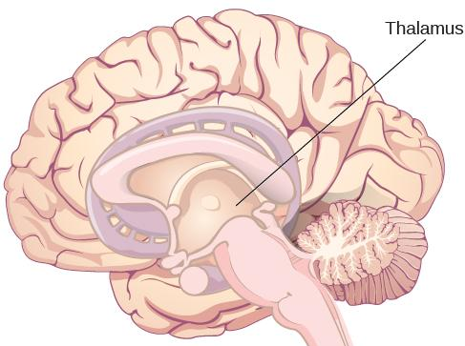
THE THALAMUS
The thalamus serves as the relay center of the brain where most senses (excluding smell) are routed before being directed to other areas of the brain for processing.

Slide 53
THE LIMBIC SYSTEM (1)
The Limbic system is involved in mediating emotional response and memory.
It is made up of a number of different structures, some of the most important ones being:
Amygdala - involved in our experience of emotion and tying emotional meaning to our memories. Involved in processing fear.
Hippocampus - structure associated with learning and memory (in particular spatial memory).
Hypothalamus – regulates homeostatic processes including body temperature, appetite and blood pressure.

Slide 54

THE LIMBIC SYSTEM (2)

Slide 55
THE MIDBRAIN (1)
Reticular formation - important in regulating the sleep/wake cycle, arousal, alertness, and motor activity.
Substantia Nigra - where dopamine is produced; involved in control of movement.
Ventral tegmental area (VTA) - where dopamine is produced; associated with mood, reward, and addiction.
Degeneration of the Substantia Nigra and VTA is involved in Parkinson’s disease.

Slide 56
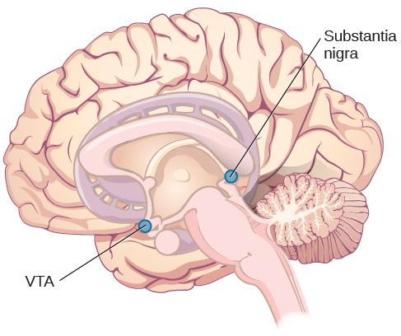
THE MIDBRAIN (2)

Slide 57
THE HINDBRAIN (1)
Medulla - controls automated processes like breathing, blood pressure, and heart rate.
Pons - connects the brain and the spinal cord; involved in regulating brain activity during sleep.
Cerebellum - controls our balance, coordination, movement, and motor skills, and it is thought to be important in processing some types of memory.
These 3 structures combined are known as the brain stem.

Slide 58
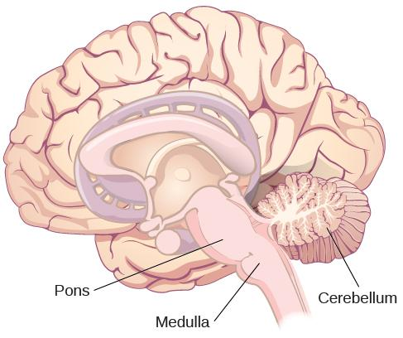
THE HINDBRAIN (2)

Slide 59
BRAIN IMAGING
Techniques Involving Radiation
CT Scan
PET Scan
Techniques Involving Magnetic Fields
MRI
FMRI
Techniques Involving Electrical Activity
EEG

Slide 60
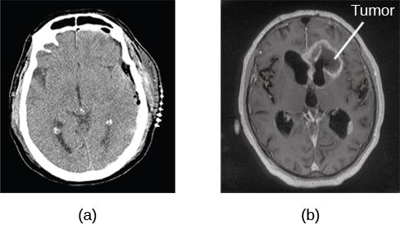
COMPUTERIZED TOMOGRAPHY (CT) SCAN
Involves x-rays and creates an image through x-rays passing through varied densities within the brain.
A CT scan be used to show brain tumors.
The image on the left shows a healthy brain, whereas
The image on the right indicates a brain tumor in the left frontal lobe.

Slide 61
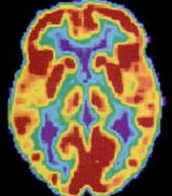
POSITRON EMISSION TOMOGRAPHY
(PET) SCAN
Involves injecting individuals with a mildly radioactive substance and monitoring changes in blood flow to different regions of the brain.
A PET scan is helpful for showing activity in different parts of the brain.

Slide 62
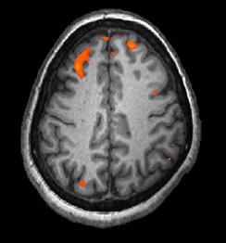
MRI AND FMRI
Magnetic resonance imaging (MRI) - magnetic fields used to produce a picture of the tissue being imaged.
Functional magnetic resonance imaging (fMRI) - MRI that show changes in metabolic activity over time.

Slide 63
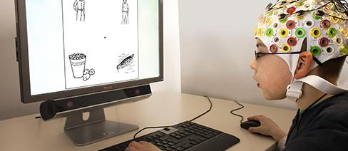
ELECTROENCEPHALOGRAPHY (EEG)
Involves recording the electrical activity of the brain via electrodes on the scalp.
Using caps with electrodes, modern EEG research can study the precise timing of overall brain activities by tracking amplitude and frequency of brainwaves.

Slide 64
Lesions (1 of 3)
General term for damage to the physical structure of the brain

Slide 65
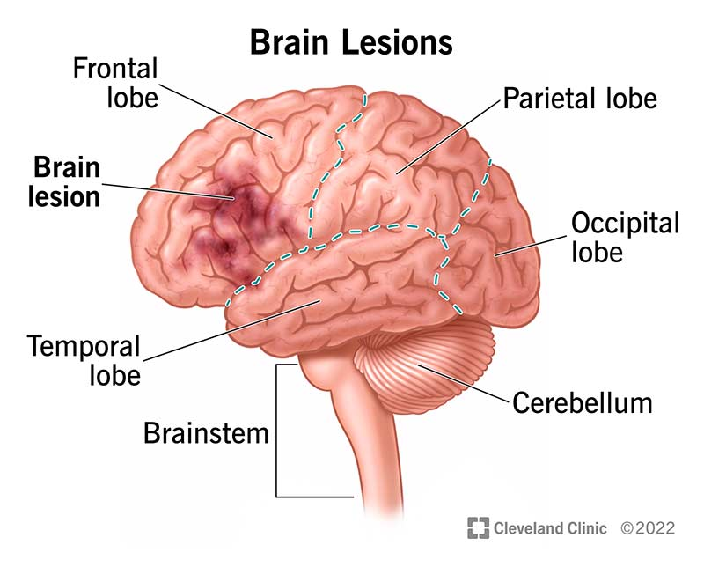

Slide 66
Lesions (2 of 3)
Two types:
  Damage from injury/illness
  Surgical lesions
Why surgical lesions?

Slide 67
Lesions (3 of 3)
Neurosurgery
  Lengthy history dating to ancient times
    Incas: Trepanation
  Modern:
    Tumor removal (first successful in 1884)
    Lobotomies (1940s – 1950’s -- highly controversial)
    Implanting electrodes in brain (1950) → Cohlear implants (1972)
  How can neurosurgery be used to learn about brain functions?
  Ethical implications?

Slide 68
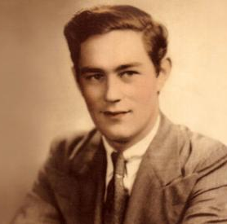
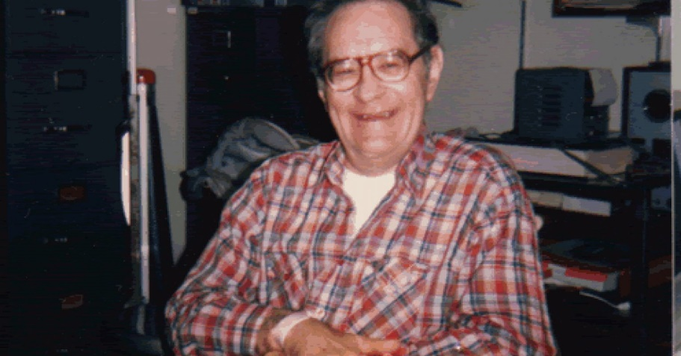
Patient HM (1 of 3)
Henry Molaison (1926 - 2008)
Suffered from severe epilepsy in childhood
Age of 27, had experimental neurosurgery to remove both hippocampi
Notes:
Satisfies Learning Objective 4: Assess the role of neuropsychology in understanding the neuroscience of memory.
The case of Phineas Gage:
Phineas Gage was a survivor of an accident that left him with a brain injury, altering his cognitive and emotional abilities, as well as his personality.
The study of the change in his behavior set the stage for the development of neuropsychology.
Research goal of neuropsychology: Correlating behavioral deficits or cognitive changes with the area of the brain that is damaged.
Anterograde amnesia and retrograde amnesia:
Anterograde amnesia: An inability to form new memories following brain damage.
Retrograde amnesia: An inability to retrieve memories of events prior to brain damage.
Relation of deficits in cognition and behavior: Neuropsychologists examine these relations with the locus of damage within the person’s brain.

Slide 69
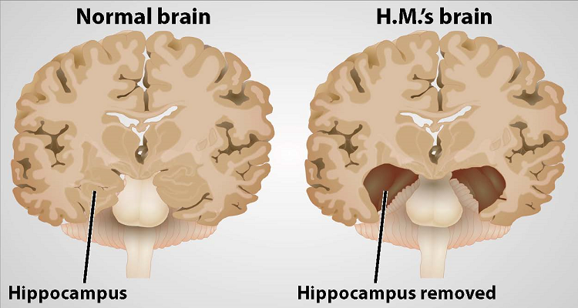
Patient HM (2 of 3)

Slide 70
Patient HM (3 of 3)
How was HM’s memory affected by the surgery?
Notes:
Satisfies Learning Objective 4: Assess the role of neuropsychology in understanding the neuroscience of memory.
The case of Phineas Gage:
Phineas Gage was a survivor of an accident that left him with a brain injury, altering his cognitive and emotional abilities, as well as his personality.
The study of the change in his behavior set the stage for the development of neuropsychology.
Research goal of neuropsychology: Correlating behavioral deficits or cognitive changes with the area of the brain that is damaged.
Anterograde amnesia and retrograde amnesia:
Anterograde amnesia: An inability to form new memories following brain damage.
Retrograde amnesia: An inability to retrieve memories of events prior to brain damage.
Relation of deficits in cognition and behavior: Neuropsychologists examine these relations with the locus of damage within the person’s brain.

